Slide 1
Verifiable Mixnets
Sandra Guasch Castelló
PhD evoting workshop
Luxembourg, 15-16/10/2012
Supervisor: paz morillo bosch

Slide 2
INDEX
Introduction
  Counting methods for electronic voting.
  Verifiability of the counting process.
Verifiable Mixnets
  Verificatum:
    Properties of a permutation matrix.
    Commitment to a permutation matrix.
  Other approaches:
    Vector Commitments.
    Cryptographic Accumulators.

Slide 3
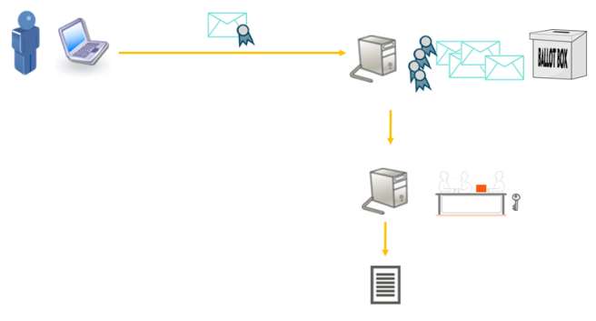
INTRODUCTION
Counting methods for electronic voting:
  In case encrypted votes are linked to voter identities (digitally signed), the counting phase has to implement procedures for preserving vote secrecy.

Slide 4
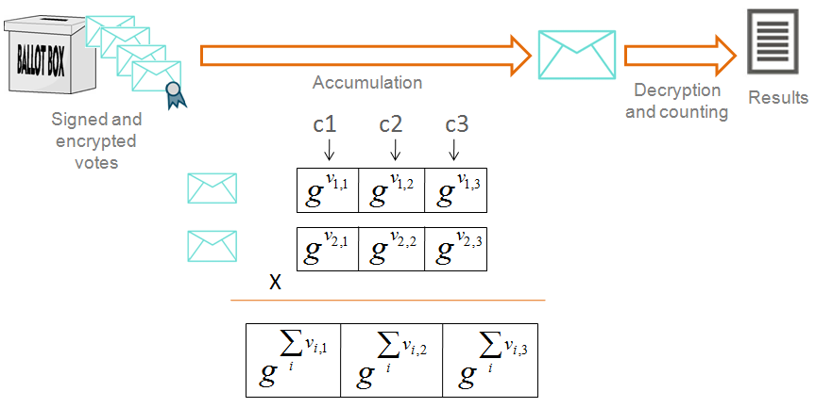
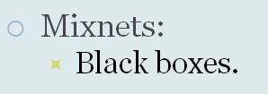
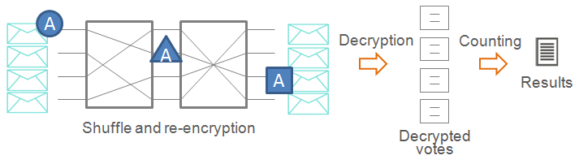
INTRODUCTION
Counting methods for providing vote secrecy:
  Homomorphic tally:
    Poor scalability and flexibility.

Slide 5
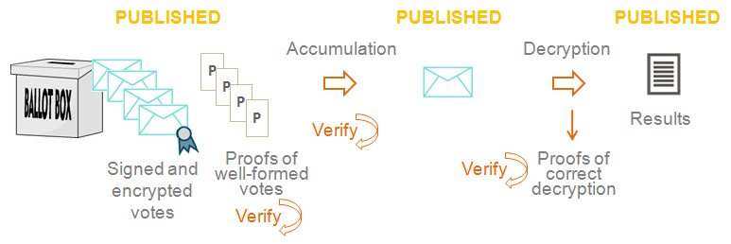
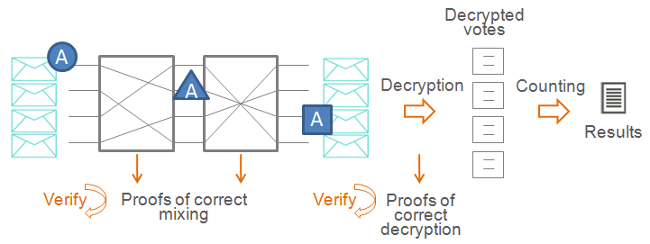
INTRODUCTION
Verifiability of the counting process:
  Homomorphic tally:

Slide 6
Verifiable Mixnets
verificatum

Slide 7
Verificatum: a verifiable mixnet
Based in two papers:
  D. Wikström. A Commitment-Consistent Proof of a Shuffle. 2011.
    Generic design of a mixnet verification process divided in two phases.
    The heavier computations are moved to a pre-computation phase.
  B. Terelius, D. Wikström. Proofs of Restricted Shuffles. AfricaCrypt 2010.
    Use a matrix commitment to prove the properties of this matrix.
    Define the properties of a permutation matrix.

Slide 8
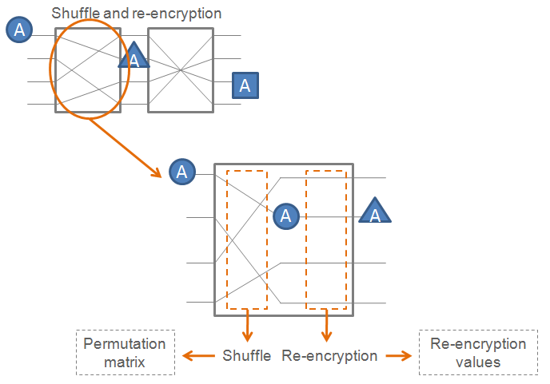
D. Wikström. A Commitment-Consistent Proof of a Shuffle. 2011.
How to proof that the mixing has been performed correctly?
Operations:
  Shuffle or permutation.
  Re-encryption.

Slide 9
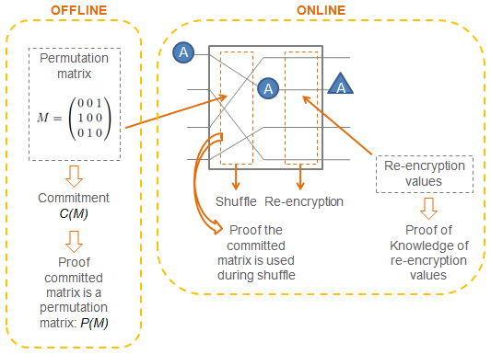
D. Wikström. A Commitment-Consistent Proof of a Shuffle. 2011.
Division in two processes:
  Offline or computed before mixing.
  Online or computed during mixing.

Slide 10
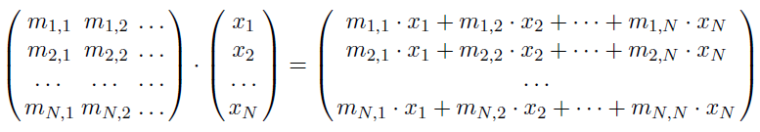
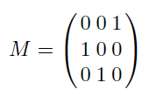
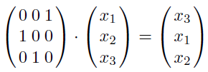


B. Terelius, D. Wikström. Proofs of restricted shuffles. 2010
Product of a matrix and a vector:
Permutation matrix:
Characteristics:
  The product of the output elements is equal to the product of the input elements:
  No linear combinations are done:
  That means: the output contains the same elements than the input.

Slide 11


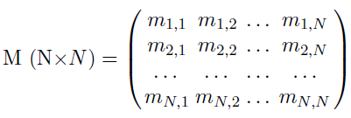

Commitment to a permutation matrix
Pedersen commitment:
  Commitment to a value m:
  Commit to a vector :
Commit to a matrix:
  Commit to each column j:
  Commit all the columns a_{j} together:

Slide 12

Commitment to a permutation matrix
Note that:
Remember:
  Vector e permuted as defined by matrix M.
  The result of multiplying vector e by matrix M.

Slide 13


Commitment to a permutation matrix
Remember characteristics of M:
  The output contains the same elements than the input vector:
    We will use:
  No linear combinations are done:
    We will use:

Slide 14





Commitment to a permutation matrix
Proofs over the commitment of M:
  From the commitment of :
    Where is the permutation of
  Prove that
  The verifier checks that
  has an exponential form.
  This is the heaviest part of the computation,
  but it’s done in the offline phase.
  The prover has to do step-by-step the product of the values e’_{i} .
  …

Slide 15
Verificatum times
  Java implementation.
  Commitment to an initial matrix of 18.284 votes, mixing of 9.142 votes.
 | minutes
Offline: | 87,09
Commitment to a matrix | 23,17
Check matrix commitment: | 59,17
Pre-generate re-encryption exponents: | 4,76
Online: | 18,04
Perform mixing: | 0,02
Prove mixing: | 3,97
Validate mixing: | 14,05
  I5-2400 8GB RAM
  3VMs (1 core, 2GB RAM)
  VirtualBox 4.1.18
  Verificatum 1.0.7.

Slide 16
Verifiable Mixnets
Other approaches

Slide 17
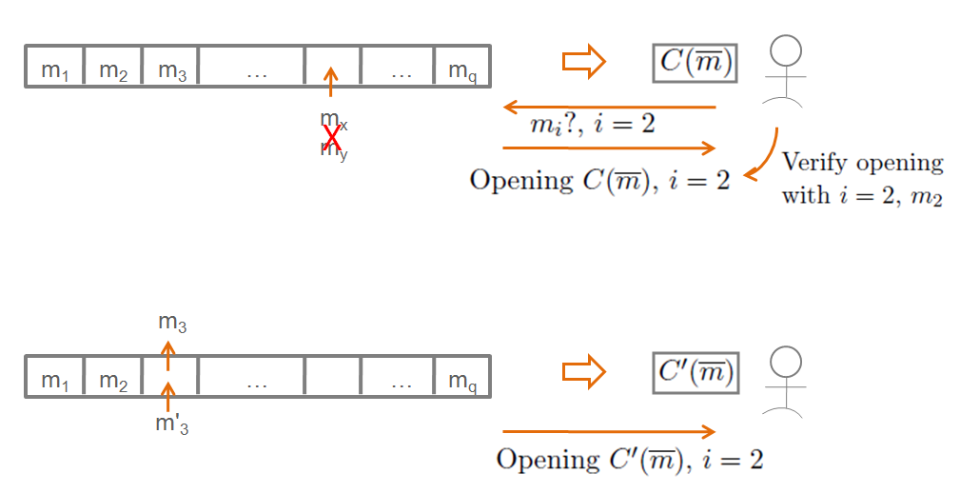
D. Catalano and D. Fiore. Vector Commitments and their Applications. 2011.
* Commitment to a vector of q messages.
* The commitment can be opened to a specific position.
* Position binding: the commitment cannot be opened to two different values for the same position.
* Size of commitment and openings is independent of q.
* Commitment and openings are updatable.

Slide 18
Proving mixing with Vector Commitments
Idea: we want to prove that we have commited to a permutation matrix (like Wikström).
  Commit to each row of M with a Vector Commitment.
  Make an opening to value ‘0’ that can be used for all positions but one.
  Make an opening to value ‘1’ for one position.
    Without revealing that position.
  Vector Commitments shall allow relating the commited matrix to the operations of the Mixnet.
  Only one ‘1’per column and row.

Slide 19
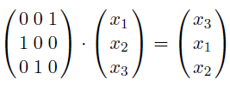
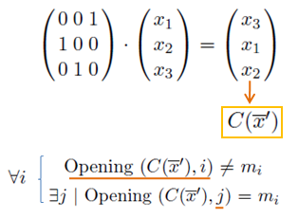
Proving mixing with Vector Commitments
Idea: what does it mean to make a shuffle?
  Messages before and after are
  the same, but in different order.
  Vector Commitments are position binding: prove both vectors have the same elements in different positions.
    Pass a test vector through the
    permutation matrix (hidden) and
    give the Vector Commitment of the
    output.
    Prove properties of the commited
    output.
  Prove them in zero knowledge.

Slide 20
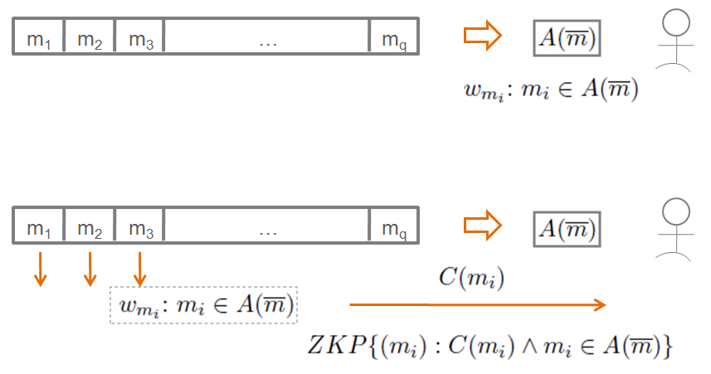
J. Camenish and A. Lysyanskaya. Dynamic Accumulators and Application to Efficient Revocation of Anonymous credentials. 2002.
* Compress a list of q elements into a single accumulator value.
* For each element, a witness w attests that it is in the accumulator.
* Camenish and Lysyanskaya: prove in zero knowledge that an element is in the accumulator.
* Can be used to prove in zero knowledge that an element belongs to a set.
* The accumulator can be updated to allocate new values.
* Universal accumulators (J. Li, N. Li, R. Xue. Universal Accumulators with Efficient Non-membership Proofs. 2007.) allow also to issue proofs of non-membership.

Slide 21
Proving mixing with Vector Commitments and Accumulators
Idea: we want to prove that two vectors contain the same values but in different order (without learning that order).
  Compare the vector commitment of the output does not open to the same values than in the input for all the positions ←in zero knowledge!
  Use a cryptographic accumulator to represent the set of input values, and demostrate that all the output values in the vector commitment are contained in the accumulator.

Slide 22
Challenges
Make Vector Commitments homomorphic in some way:
  Vector Commitments shall allow relating the committed values to the operations of the mixnet.
  We want to be able to relate a committed vector to values in an accumulator.
Achieve Zero-Knowledge properties:
  We want to prove a position can be opened to a value without revealing that position.

