Slide 1


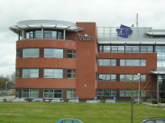
Smartgrid security
Gerben Broenink

Slide 2
Outline
Where am I coming from?
What are the (upcoming) demands to our energy infrastructure?
Challenges in our energy infrastructure
Taking up the challenges
Security research topics

Slide 3
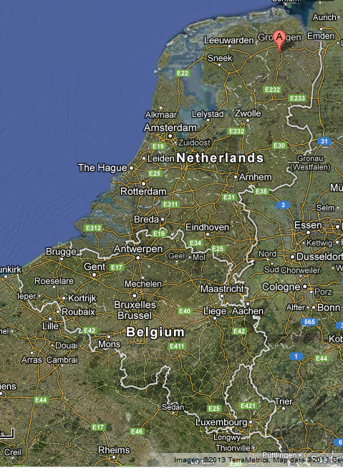
Where am I coming from?
Gerben Broenink
Background in applied computer science
Security Scientist at TNO from 2008
Research topics:
Network security (mainly for Dutch department of Defence)
Secure smartphone (mainly for Dutch department of Defence)
Smart grids (research project founded by Dutch government, and FP7 projects)

Slide 4
What are the (upcoming) demands to our energy infrastructure?
Increase of more “green” sources of energy: wind and solar
More efficiency

Slide 5


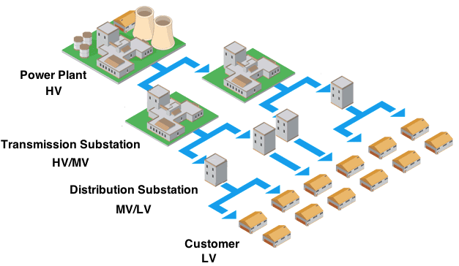
What are the (upcoming) demands to our energy infrastructure?
HV
MV
LV

Slide 6
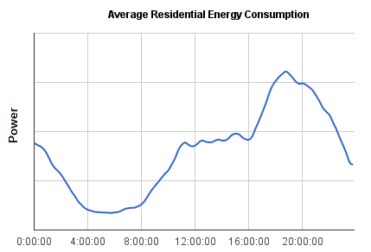
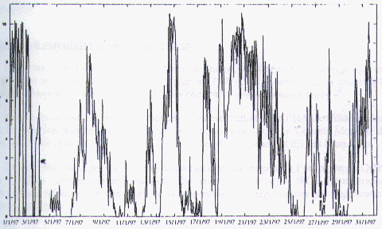
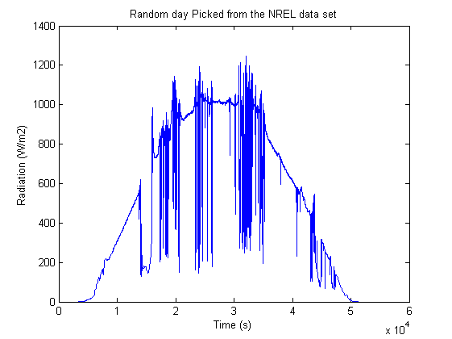
What are the (upcoming) demands to our energy infrastructure?
Production
Power plant
Wind turbine
Solar power
Balance
Total production has to match the total consumption.
Consumption

Slide 7
What information is available on the flow of electricity?
Detailed information, based on measurement data
Information, based on little measurement data
“No phone calls, no problem”

Slide 8

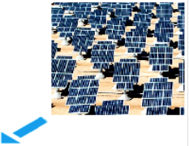


What are the (upcoming) demands to our energy infrastructure?

Slide 9
Summary of challenges to our energy infrastructure
More distributed power supply
Low amount of information for control purposes
Green energy, less controllable production
A higher peak load: risk of congestion
Consumer becomes a producer

Slide 10
Taking up the challenges

Slide 11






Taking up challenges
Solutions approaches
Smart meters
SCADA control systems
Demand Response Management

Slide 12
What is TNO doing?

Slide 13
What is TNO doing?
Smart meters:
Review on smart meter requirements
Putting privacy on the agenda
Methodical approach in risk analysis to requirements.
Review on smart meter legislation
Smart meter lab
Cost benefits analysis

Slide 14
What is TNO doing?
SCADA
Developing knowledge about SCADA and smart substations
E. Luijjf : “Assessing and Improving SCADA Security in the Dutch Drinking Water Sector.”

Slide 15


What is TNO doing?
Demand Response Mgmt
Powermatcher, a demand response management framework
Flexible power, a demand response management infrastructure

Slide 16
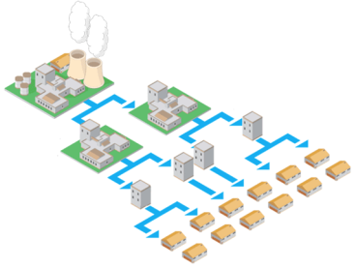
Security research topics
Where is innovation required from the security point of view?

Slide 17
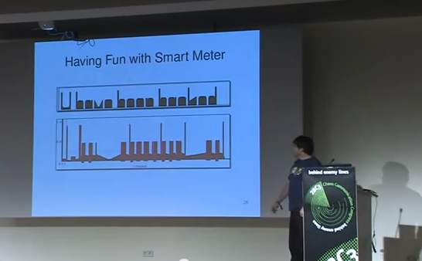
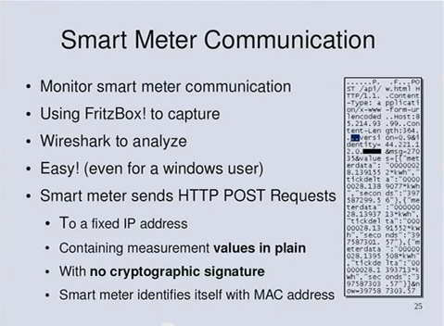
Security research topics
Security by design
ICT is introduced into a new field of expertise → many security solutions might be reinvented
Two examples:
1. First requirements document of the Dutch smart meter:
Contains the functionality of remote disconnecting users
Did not contain any security requirements about this function
2. Several smart meters communicate
without crypto. (no signing and no encryption)
Link: http://www.youtube.com/watch?v=xOArwu3lziQ

Slide 18
Security research topics
ICT becomes a new dependency
The current infrastructure runs ‘without ICT’.
When ICT fails, the energy infrastructure continues to function.
What’s happening when we design the energy infrastructure to depend on ICT?
How can we benefit from applying ICT without reducing availability and continuity?

Slide 19
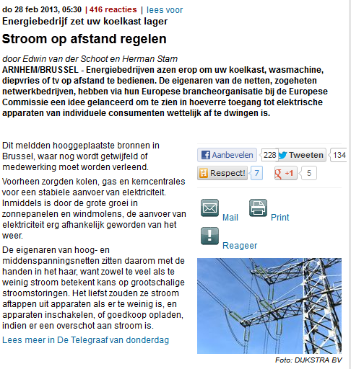
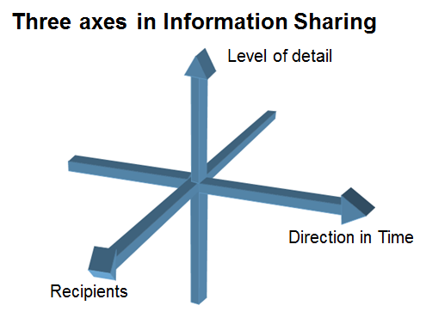
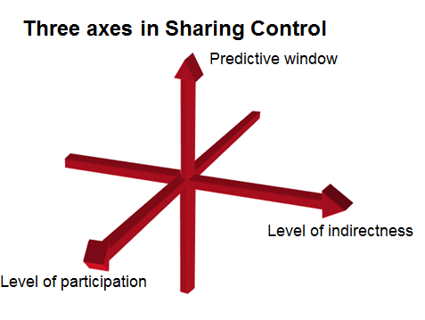
Security research topics
Privacy
Information sharing:
More information is used and communicated in the grid.
2. Demand response management,
The network influences the consumer
Link: http://www.telegraaf.nl/binnenland/21337752/__Energiebedrijf_zet_koelkast_lager__.html

Slide 20
Security research topics
Market possibilities
Many designs for Demand Response Systems introduce a market (with an accompanying) infrastructure.
The idea is that the ‘market and its rules’ will cater for availability and affordability
The market itself can introduce new risks:
due to manipulation of the market by parties using it for generating money through ‘loopholes’
People who cannot fulfil the agreements.
How can we use a market structure in a secure way?

Slide 21
Summary
Green energy source add extra demands to our energy infrastructure
Three solution directions:
Smart meters
SCADA systems
Demand response management
Several open questions:
Security by design
ICT becomes a new dependency
Privacy
Market mechanism

Slide 22
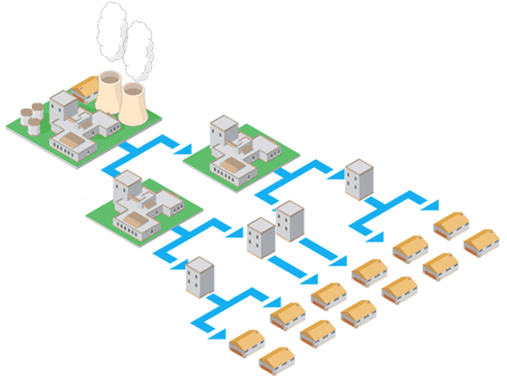
Questions?

